Slide 1
Global Layoffs Dashboard Trends and Insights
Srikanth Kondapalli

Slide 2

Agenda
Dashboard Creation Process
Key Performance Indicators (KPI)
Strengths of the Dashboard
Key Insights
Stakeholders Benefiting from the Dashboard

Slide 3
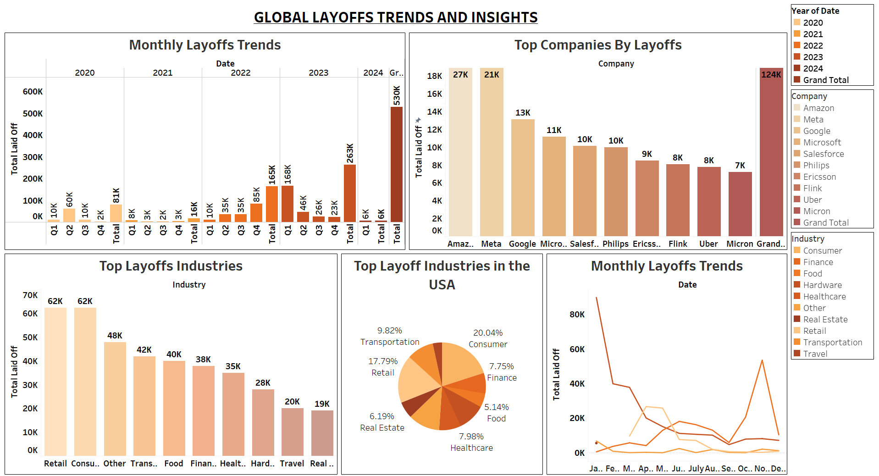

Slide 4
Dashboard Creation Process
Data Collection: Gathered data from reliable sources.
Visualization Tools: Set up data in Tableau for analysis.
Dashboard Layout: Created a clear, intuitive layout for user interaction.
Create Visualizations: Used bar and pie charts to effectively present data.
Filters and Interactivity: Added filters for year, industry, and location to allow data drill-down.

Slide 5

Key Performance Indicators (KPI)
Total Layoffs: Overall layoffs across 2020-2024.
Monthly/Quarterly Trends: Layoffs over time.
Top Companies by Layoffs: Companies with the highest layoffs.
Top Industries by Layoffs: Most affected industries.
Layoffs by Industry in the USA: Layoffs across various US industries

Slide 6
Strengths of the Dashboard
User-Friendly Interface
Interactivity and Flexibility
Comprehensive Coverage
Real-Time Decision-Making

Slide 7

Key Insights
Monthly Layoff Trends
Top Companies by Layoffs
Top Layoffs Industries
Top Layoff Industries in the USA
Monthly Layoffs by Date (Line Chart)

Slide 8
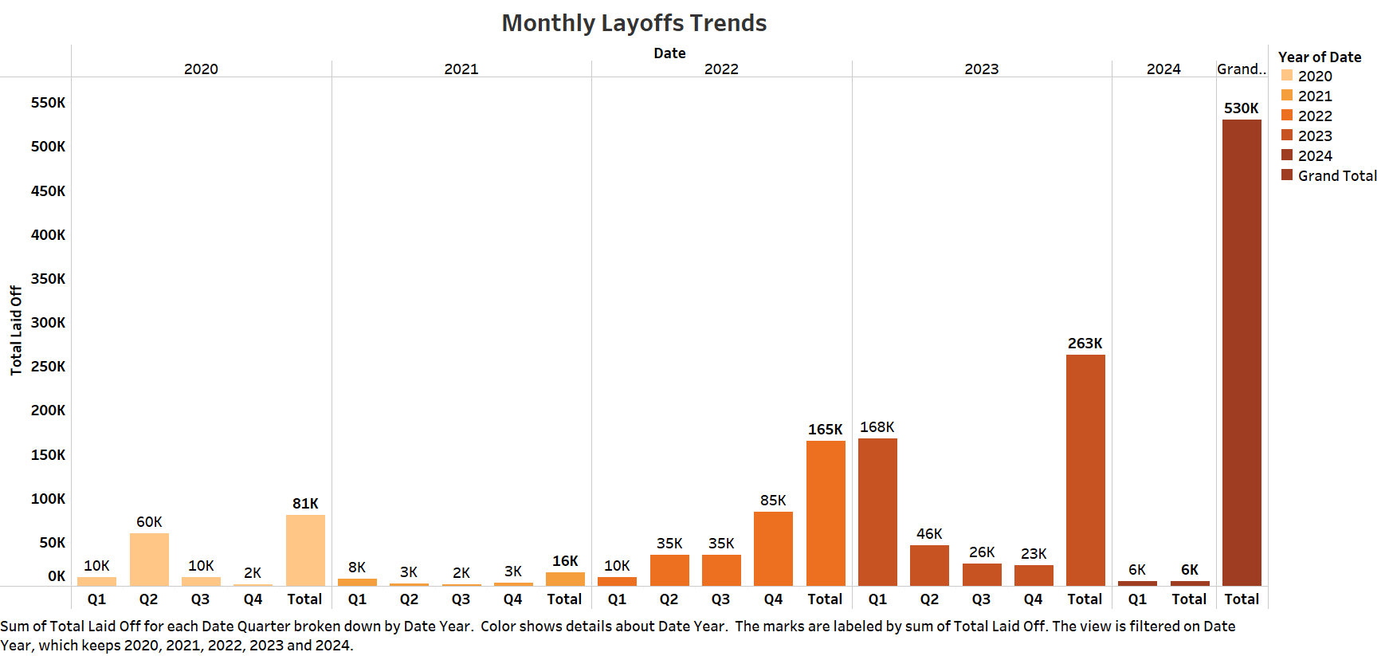
Monthly Layoff Trends
Q4 2023 saw the highest layoffs (263K).
Significant layoffs in 2022m peaking in Q1 and Q2.
Decline in 2024, with only 6k layoffs so far.

Slide 9
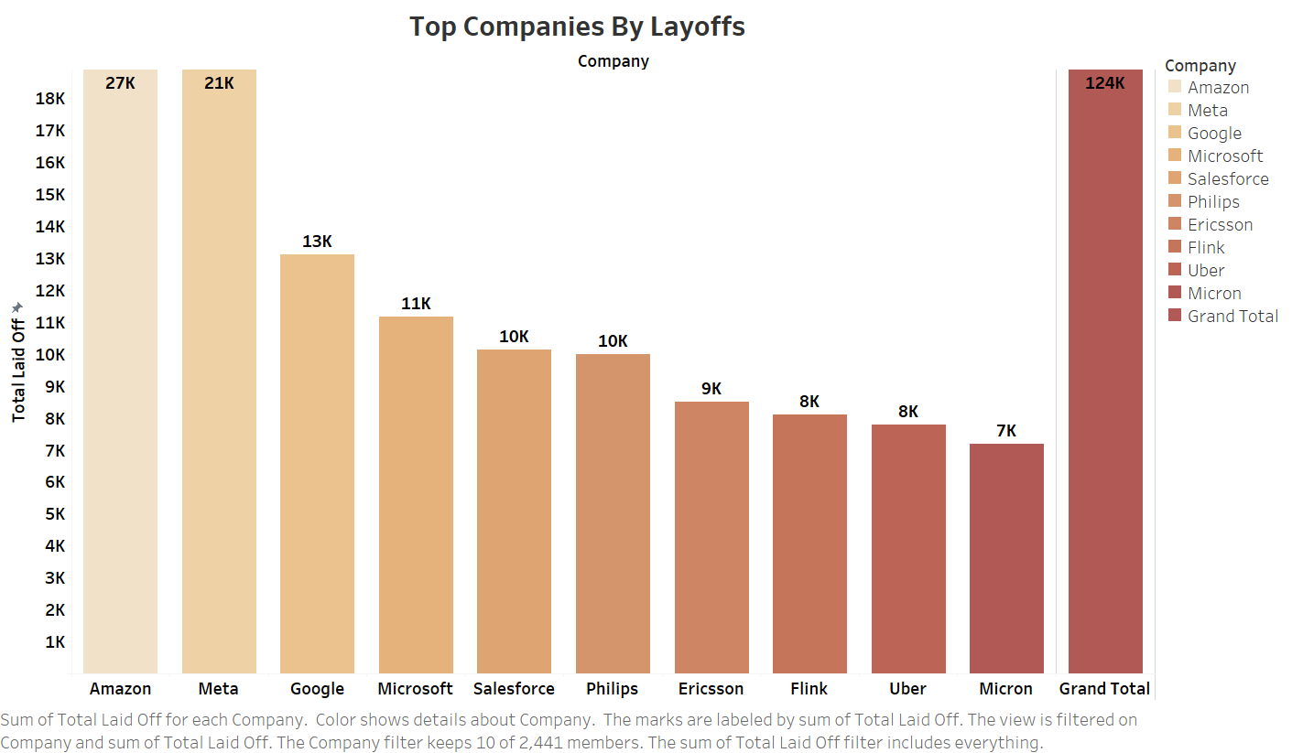
Top Companies by Layoffs
Amazon had the highest layoffs (27K), followed by Meta (21K) and Google (13K).
Tech giants like Microsoft, Salesforce, and Philips were also impacted.

Slide 10
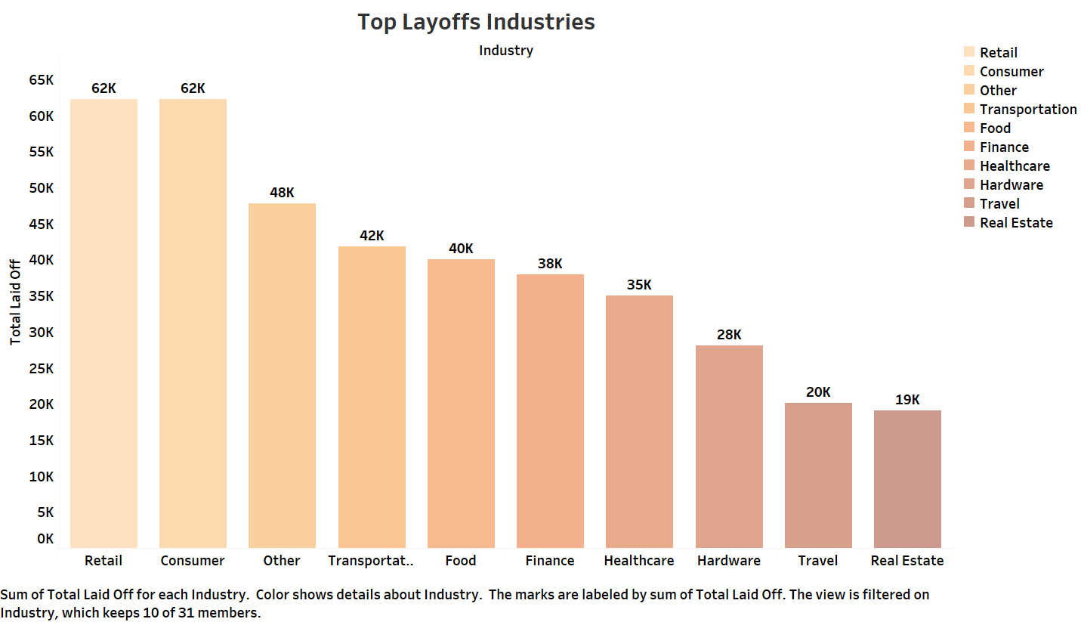
Top Layoff Industries
Retail and Consumer sectors were hit hardest (62K each).
Other key sectors: Transportation (42K), Food (40K), Finance (38K).

Slide 11
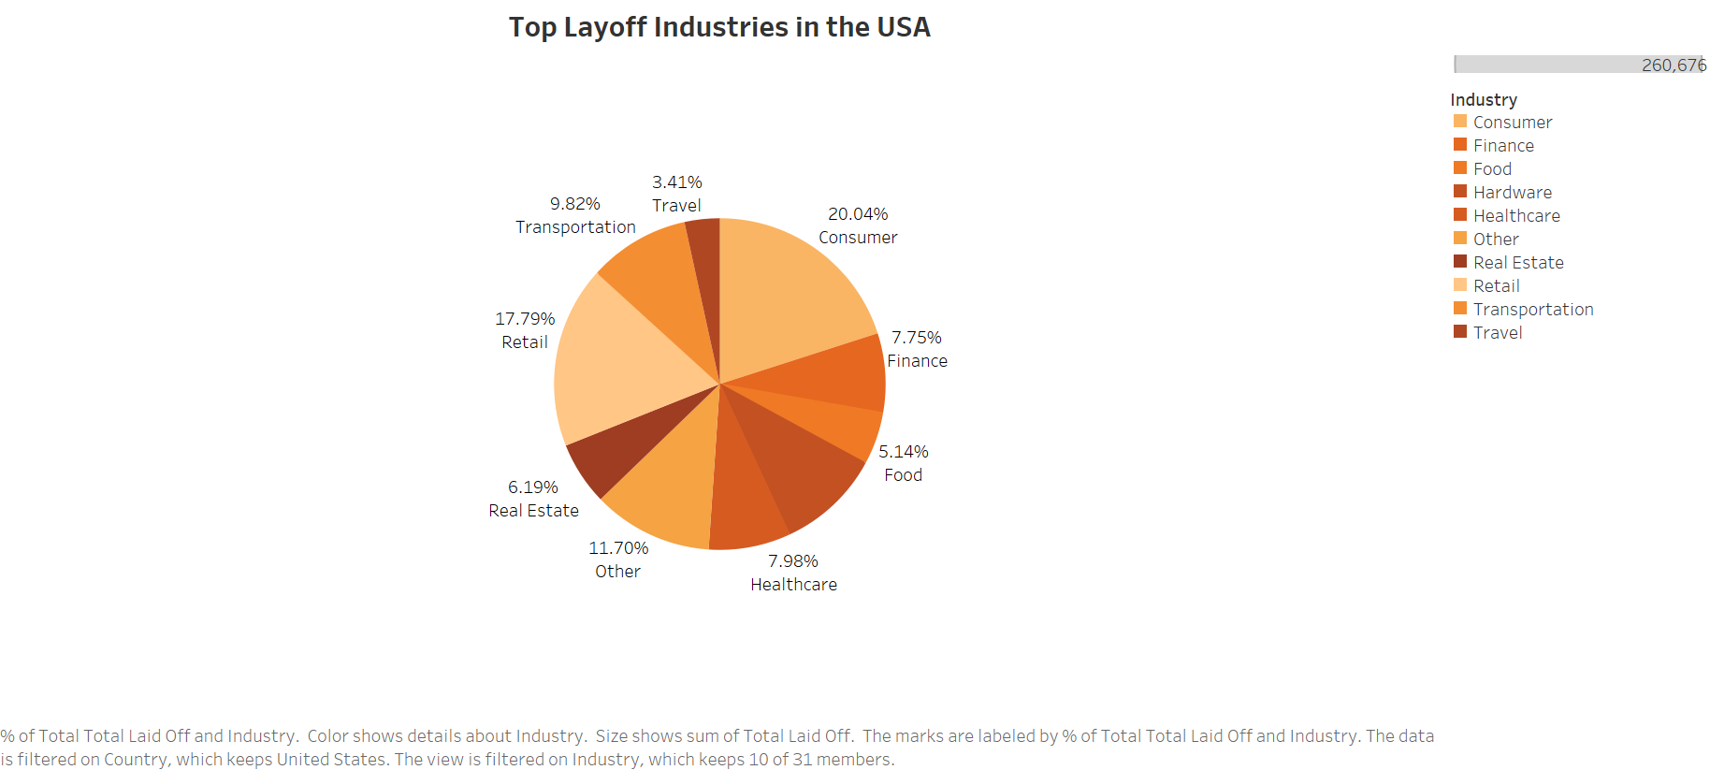
USA Top Layoff Industries
Consumer (20.04%) and Retail (17.79%) led layoffs.
Transportation (9.82%) and Finance (7.75%) also saw notable layoffs.

Slide 12
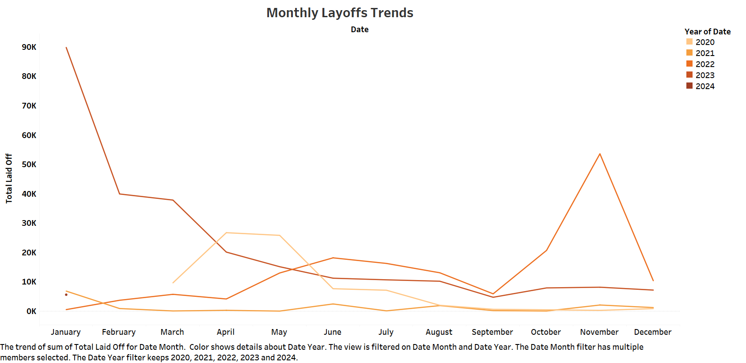
Monthly Layoffs Trends (Line)
Layoffs peaked in November 2023.
Major decline in early 2024 after smaller spikes earlier.

Slide 13

Stakeholders Benefiting from the Dashboard
Job Seekers and Career Counselors : Guide career shifts
Government and Policy Makers : Track employment trends and provide support.
HR and Workforce Teams: HR rehiring in affected regions.
Industry Analysts and Consultants: Consultants helping retail companies adapt to workforce changes

Slide 14
Thank You

